Slide 1
GANs - Generative Adversarial Networks
Week 9 Day 3 Part II
Zain Hasan
Adapted from Arunabh

Slide 2
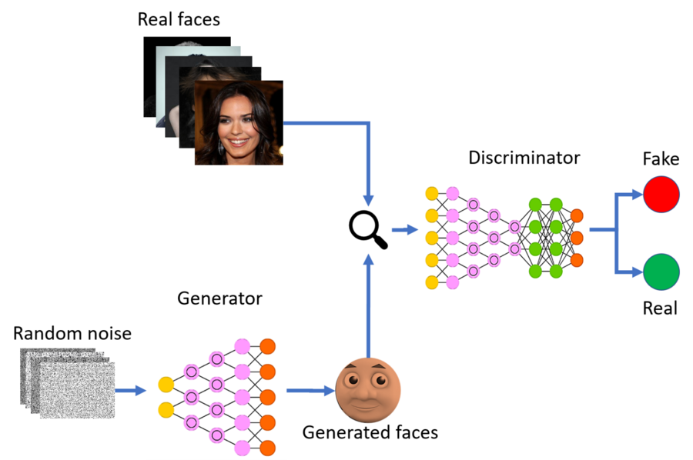
What are GAN’s
GAN stands for Generative Adversarial Networks
It consists of two Neural Networks trying to outwit each other.
These 2 networks are known as Generator and Discriminator.
GAN representation

Slide 3
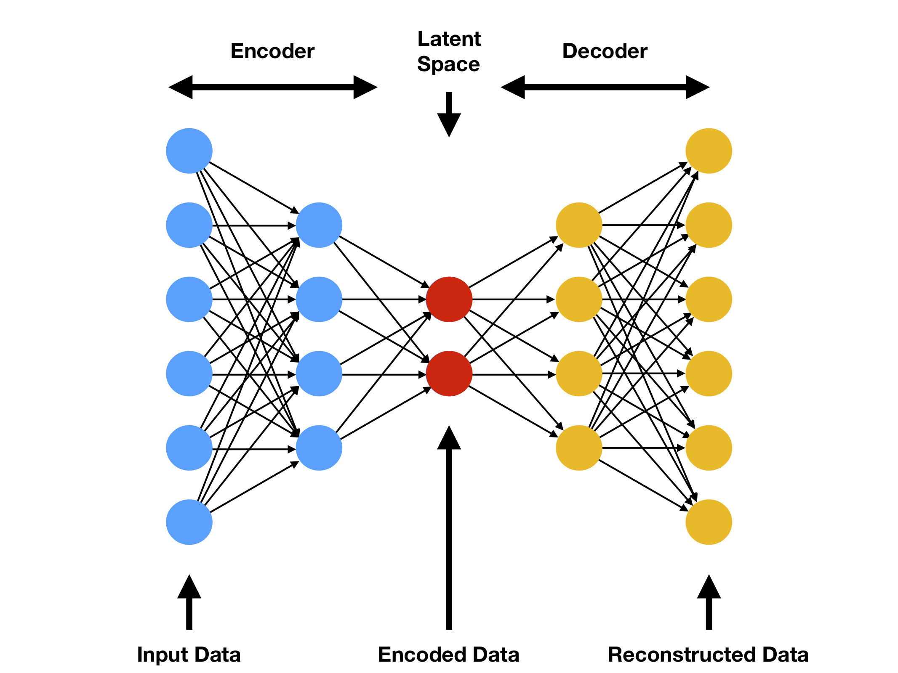
Auto Encoders
Auto Encoder is a Neural network that encodes data onto a latent space or onto a set of latent variables.
Latent space is usually lower in dimension then input space or output space.
Now with this compressed representation of the input data, it is tasked with reproducing the input sample.
The first part is known as the Encoder and the latter is known as the Decoder.

Slide 4
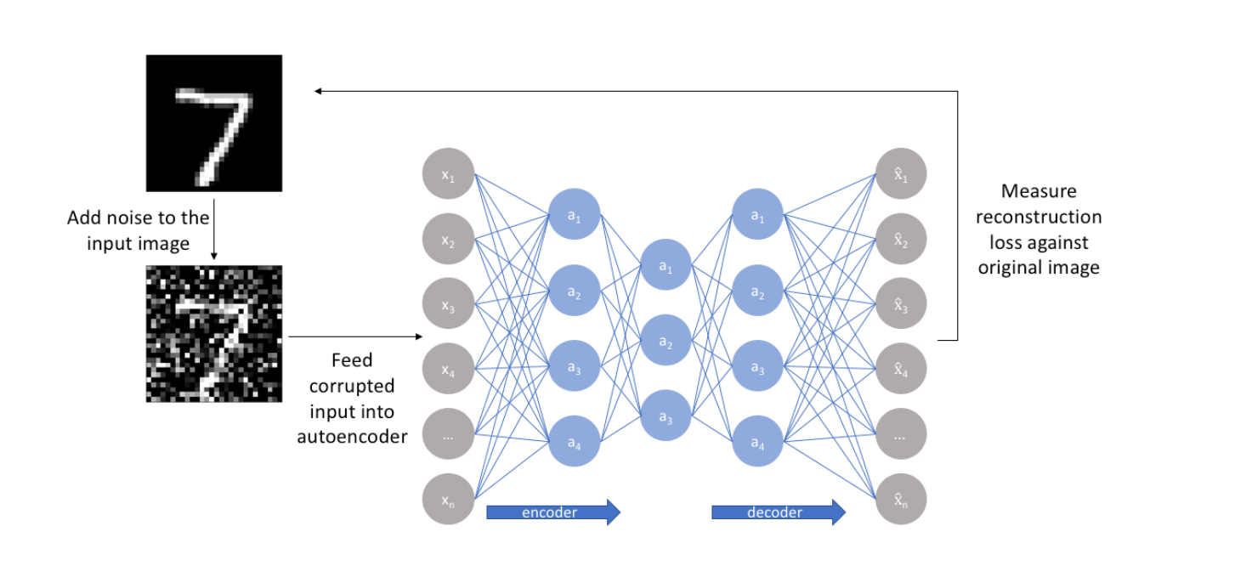
Use Case of Auto Encoders
Auto encoders can reconstruct an image and denoise it.
This is just one of many, many applications of AEs.
CAN YOU NAME ONE MORE APPLICATION?
To learn more about GANs we need to find out how autoencoders learn to do this.
Cost-Function:
Penalize deviations from y and y_hat.

Slide 5
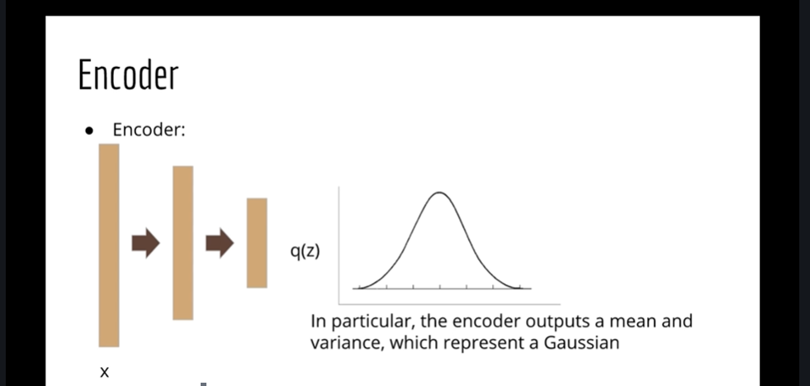
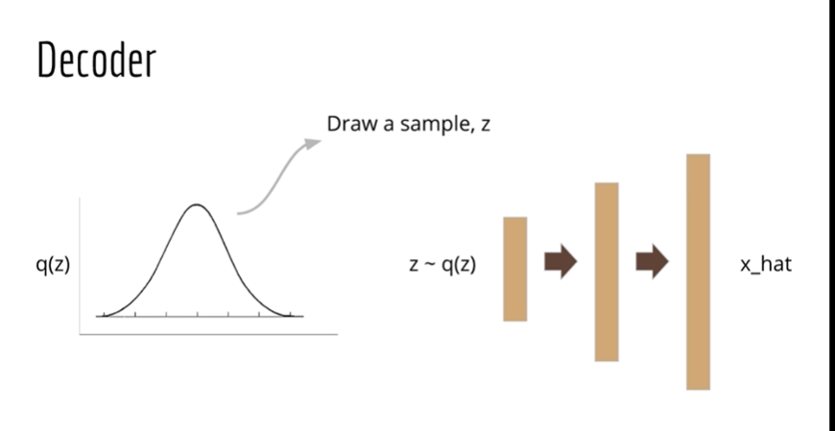
Gaussian Latent Space
Auto Encoder generates the parameters (mean, dev) that define a distribution in hidden layer or latent space.
This is used to draw samples and create new outputs.
This is known as a Variational AE – it is a generative model
Source: Udemy-Lazy Programmer

Slide 6
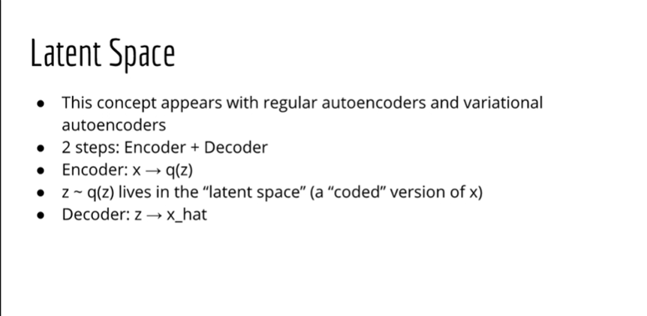
Algorithm behind an Auto-Encoder
Source: Udemy-Lazy Programmer

Slide 7
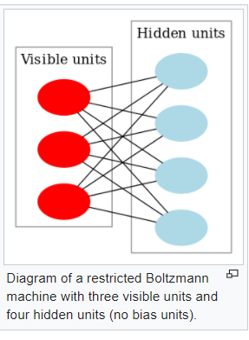
Comparison with other probabilistic models
Restricted Boltzmann Machines can generate samples too.-RBM’s are a precursor to AE’s
But we do not know how many iterations will be good enough.
However, AE’s generate samples in a single pass.
RBM learns a distribution over its inputs.

Slide 8
Back to GANs
Generator = Decoder from AE’s
Discriminator = Classification Neural Network

Slide 9
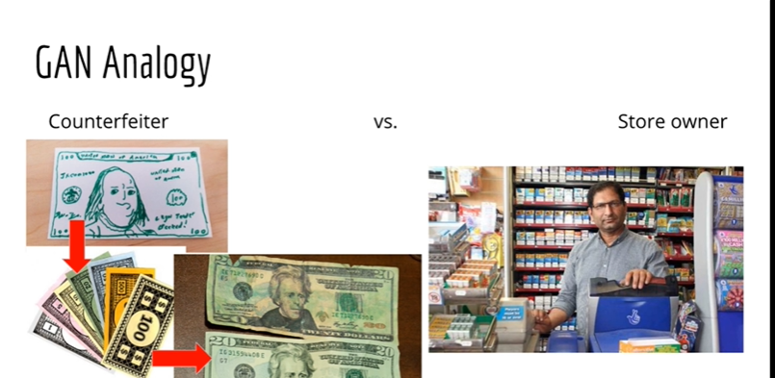
GAN Analogy – Game Theory
GANs can be thought of similar to a store owner and customer trying to use counterfeit notes.
The counterfeiter learns and tries to create more realistic counterfeit notes. (Generator)
The shopkeeper learns to discriminate between fake and real.(Discriminator)
This process can keep going on forever.
GANs do not use anything we haven’t already learnt. – This architecture of a FFN is called a GAN.
Source: Udemy-Lazy Programmer

Slide 10
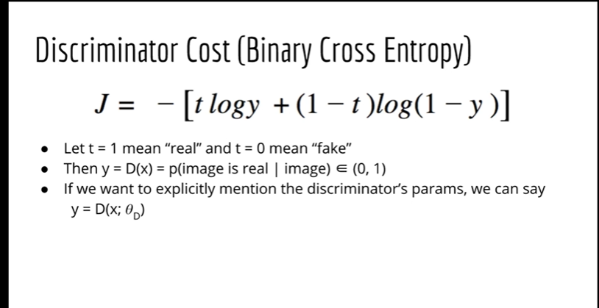
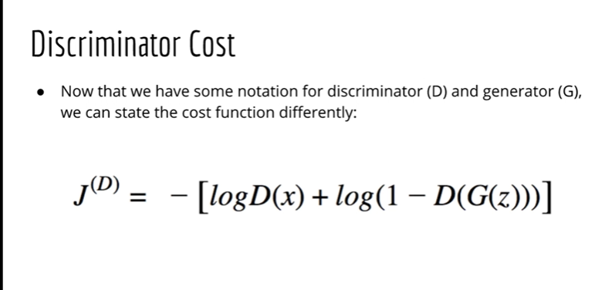
GAN Cost Functions
The two networks in a GAN are trying to “outplay” each other – hence “Adversarial”
The two networks in a GAN are trying to optimize opposite things. So we can say that the 2 cost functions need to be opposites.
We can say there are two classes that a discriminator is trying to predict. One is real sample other fake sample.
So this is a binary classification problem and we can try to use the cross entropy loss function.
Source: Udemy-Lazy Programmer

Slide 11
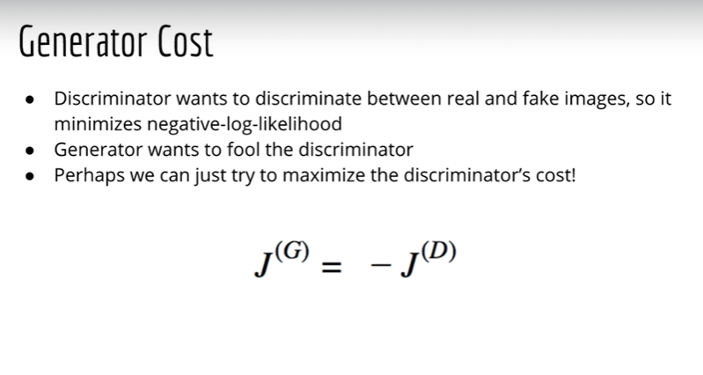
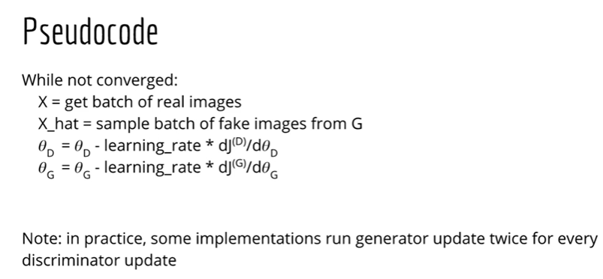
Generator Cost Function and Algorithm
Source: Udemy-Lazy Programmer

Slide 12
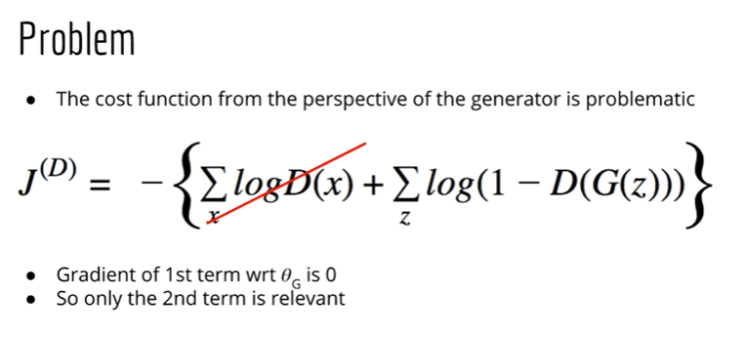
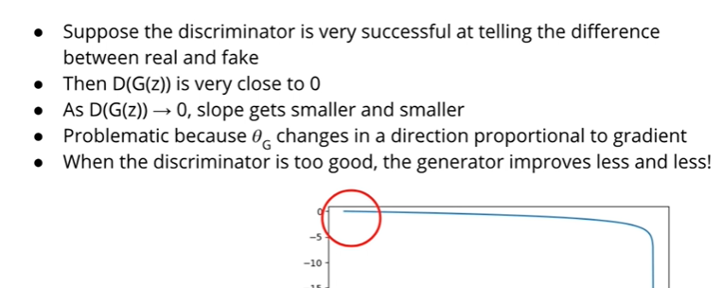
Correcting cost function for Generator
Source: Udemy-Lazy Programmer

Slide 13
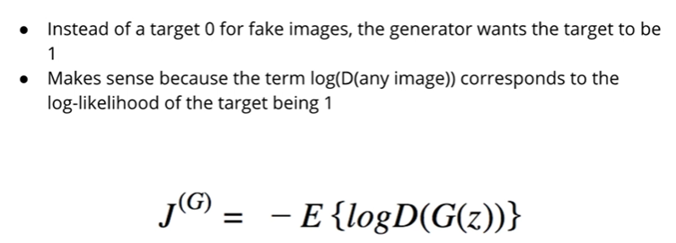
New Generator Cost
The two cost are not opposites anymore and have a zero sum.
This important to note as we optimize the GAN now.
Source: Udemy-Lazy Programmer

Slide 14
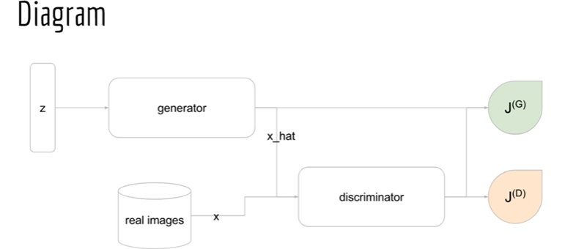
Final GAN diagram
Starting from left we have z which is a latent variable generated from a uniform distribution.
Generator will use the distribution to generate x_hat or fake samples.
Discriminator will be fed both real and fake images.
Then we have cost functions which optimize both the networks respectively.
Source: Udemy-Lazy Programmer

Slide 15
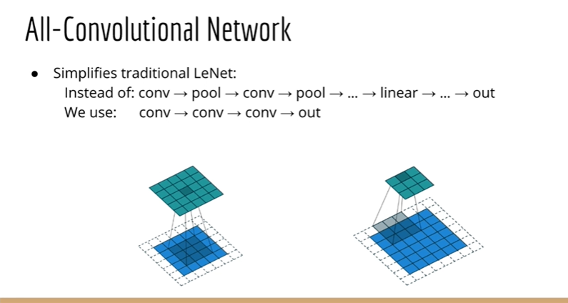
DCGAN – Deep Convolutional GAN
The Generator is a CNN and the Discriminator is a Classification CNN.
Uses batch normalization which means normalizing the data at every layer in a Neural Network.
DCGAN follows a style of Neural Network called All Convolutional Network.
This Network does not uses pooling layer to reduce dimensions. Instead just uses bigger stride of 2.

Slide 16
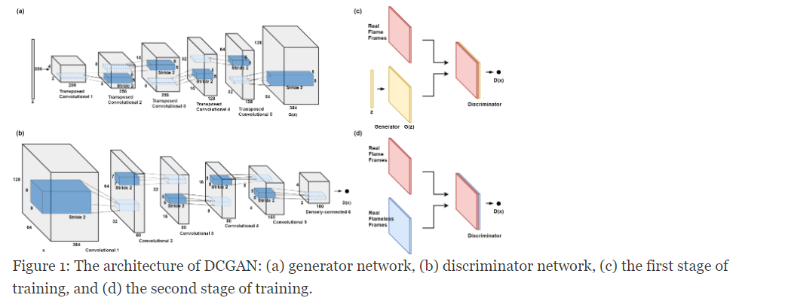
DCGAN overall structure

Slide 17
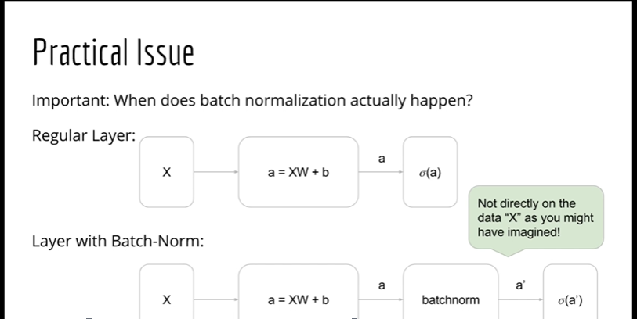
Batch Normalization 1
Batch normalization happens as follows:
First-→ weights*X + bias
Second → Batch Normalization
Third → activation function

Slide 18
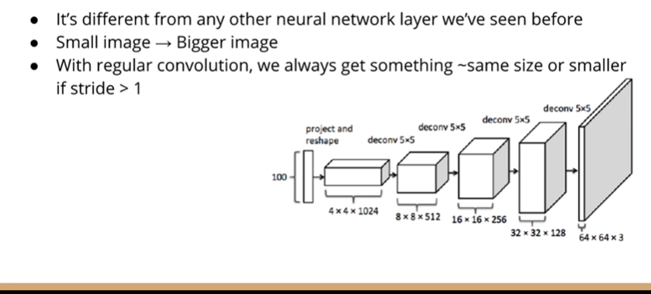
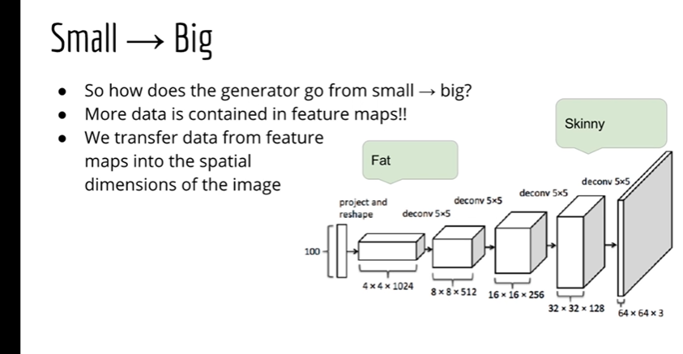
Transpose Convolutions

Slide 19
